Slide 1
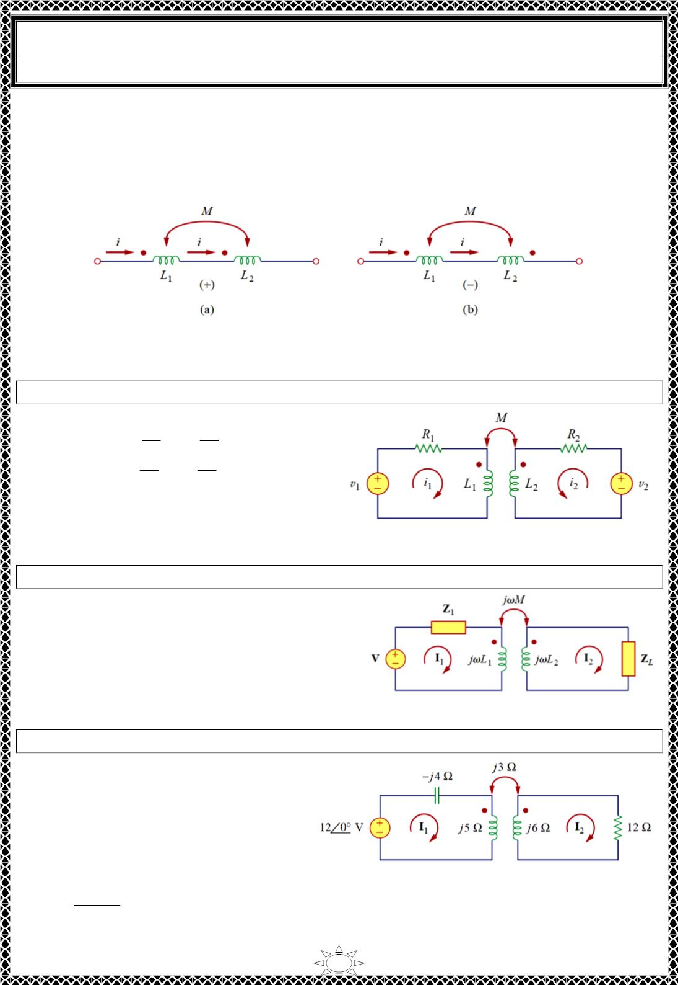
University of Diyala
Engineering College
Electronic Department
Electrical Circuits
2nd Class
Lecturer : Wisam N. AL-Obaidi
Year (2015-2016)
Fig.5.5 shows the dot convention for coupled coils in series. For the coils in Fig.5.5 (a),
the total inductance is
L = L + L + 2M
(Series-aiding connection)
1
2
For the coils in Fig.5.5 (b),
L = L + L - 2M
(Series-opposing connection)
1
2
Fig.5.5 Dot convention for coils in series; (a) series-aiding connection, (b) series-opposing
connection.
Example 1: Apply KVL for circuit shown in time domain and in frequency domain
Solution:
^{푑ꢀ}ꢁ
^{푑ꢀ}2
푣 = 푖 푅 + 퐿
1
+ 푀
+ 푀
1
1
1
Trail Version
Trail Version
Trail Version
Trail Version
Trail Version
Trail Version
Trail Version
Trail Version
Trail Version
Trail Version
Trail Version
Trail Version
Trail Version
푑푡
푑푡
푑ꢀ
푑ꢀ
푣 = 푖 푅 + 퐿
ꢂ
2
ꢁ
ꢂ
ꢂ
ꢂ
푑푡
푑푡
or in frequency domain,
V = ( 푅 + 푗휔퐿 )퐼 + 푗휔푀퐼
1
1
1
1
ꢂ
V = 푗휔푀퐼 + ( 푅 + 푗휔퐿 )퐼
ꢂ
ꢂ
1
ꢂ
ꢂ
Example 2: Apply KVL for circuit shown in frequency domain
Solution:
푉 = ( 푍 + 푗휔퐿 )퐼 − 푗휔푀퐼
1
1
1
ꢂ
0 = −푗휔푀퐼 + ( 푍 + 푗휔퐿 )퐼
ꢂ
1
ꢃ
ꢂ
Example 3: Calculate the phasor currents I and I in the circuit shown
Solution:
Apply KVL for coil 1,
1
2
−ꢄꢅ + (−푗4 + 푗5)퐼 − 푗3퐼 = 0
1
ꢂ
∴ 푗퐼 − 푗3퐼 = ꢄꢅ
…(1)
1
ꢂ
Apply KVL for coil 2,
−푗3퐼 + (ꢄꢅ + 푗6)퐼 = 0
1
(1ꢂꢆꢇꢈ)
ꢂ
∴ 퐼₁ =
ꢇꢉ
퐼_{ꢂ} = (ꢅ − 푗4)퐼_{ꢂ} …(2)
6

Slide 2
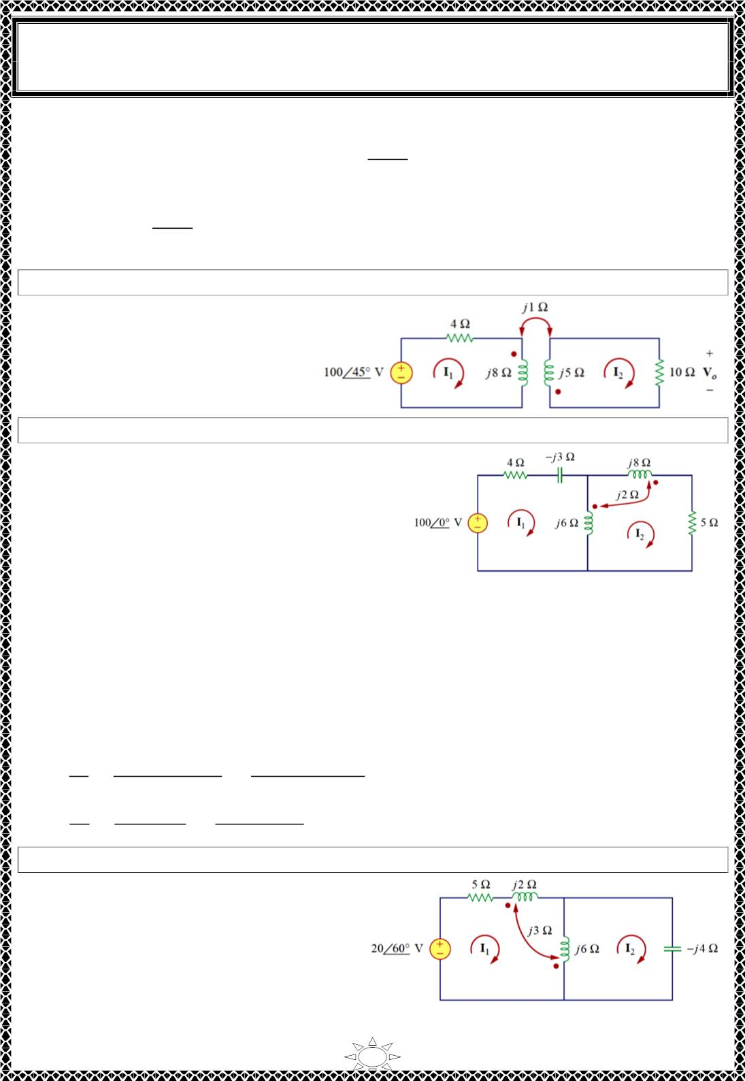
University of Diyala
Engineering College
Electronic Department
Electrical Circuits
2nd Class
Lecturer : Wisam N. AL-Obaidi
Year (2015-2016)
Substitute Equ.s (2) in (1), we get,
12
∴ 퐼ꢀ =
= 2.91∠14.04^{표} 퐴
푗(2 − 푗4)퐼 − 푗3퐼 = 12
→
ꢀ
ꢀ
4 − 푗
Now subs the value of I in Equ. (2) we get,
12
2
퐼ꢁ = (2 − 푗4)×
4 − 푗
= 13.01∠−49.39^{표} 퐴
H.W.1: Determine the voltage Vo in the circuit shown.
Answer:
푉_{표} = 10∠−135^{표} 푉
Example 4: Calculate the mesh currents in the circuit shown
Solution:
Apply KVL for loop 1,
Trail Version
Trail Version
Trail Version
Trail Version
Trail Version
Trail Version
Trail Version
Trail Version
Trail Version
Trail Version
Trail Version
Trail Version
Trail Version
−100 + 퐼 (4 − 푗3 + 푗6) − 푗6퐼 − 푗2퐼 = 0
ꢁ
ꢀ
ꢀ
∴ (4 + 푗3)퐼 − 푗8퐼 = 100
…(1)
ꢁ
ꢀ
Apply KVL for loop 2,
−푗2퐼 − 6푗퐼 + (푗6 + 푗8 + 푗2×2 + 5)퐼 = 0
ꢁ
ꢁ
ꢀ
∴ −푗8퐼 + (5 + 푗18)퐼 = 0
…(2)
ꢁ
ꢀ
Solve Equ.s (1) & (2) using matrix,
4 + 푗3
−푗8 5 + 푗18 퐼
−푗8
4 + 푗3
−푗8 5 + 푗18
퐼
100
0
−푗8
ꢁ
[
] [ ] = ꢂ
ꢃ , ∆ = |
| = 30 + 푗87 ,
100
0
ꢀ
∆ꢁ = |
−푗8
5 + 푗18
4 + 푗3 100
−푗8
| = 100(5 + 푗18) , ∆ꢀ = | | = 푗800
1868.2∠74.5^{표}
92.03∠71^{표}
0
퐼ꢁ =
퐼ꢀ =
∆ꢁ 100(5 + 푗18)
= 20.3∠3.5^{표} A
∆
=
30 + 푗87
=
∆ꢀ
푗800
800∠90^{표}
= 8.693∠19^{표} A
∆
=
=
92.03∠71^{표}
30 + 푗87
H.W.2: Determine the phasor currents I and I in the circuit shown.
1
2
Answer:
3.583∠86.56^{표} A, = 5.383∠86^{표} A
7

Slide 3
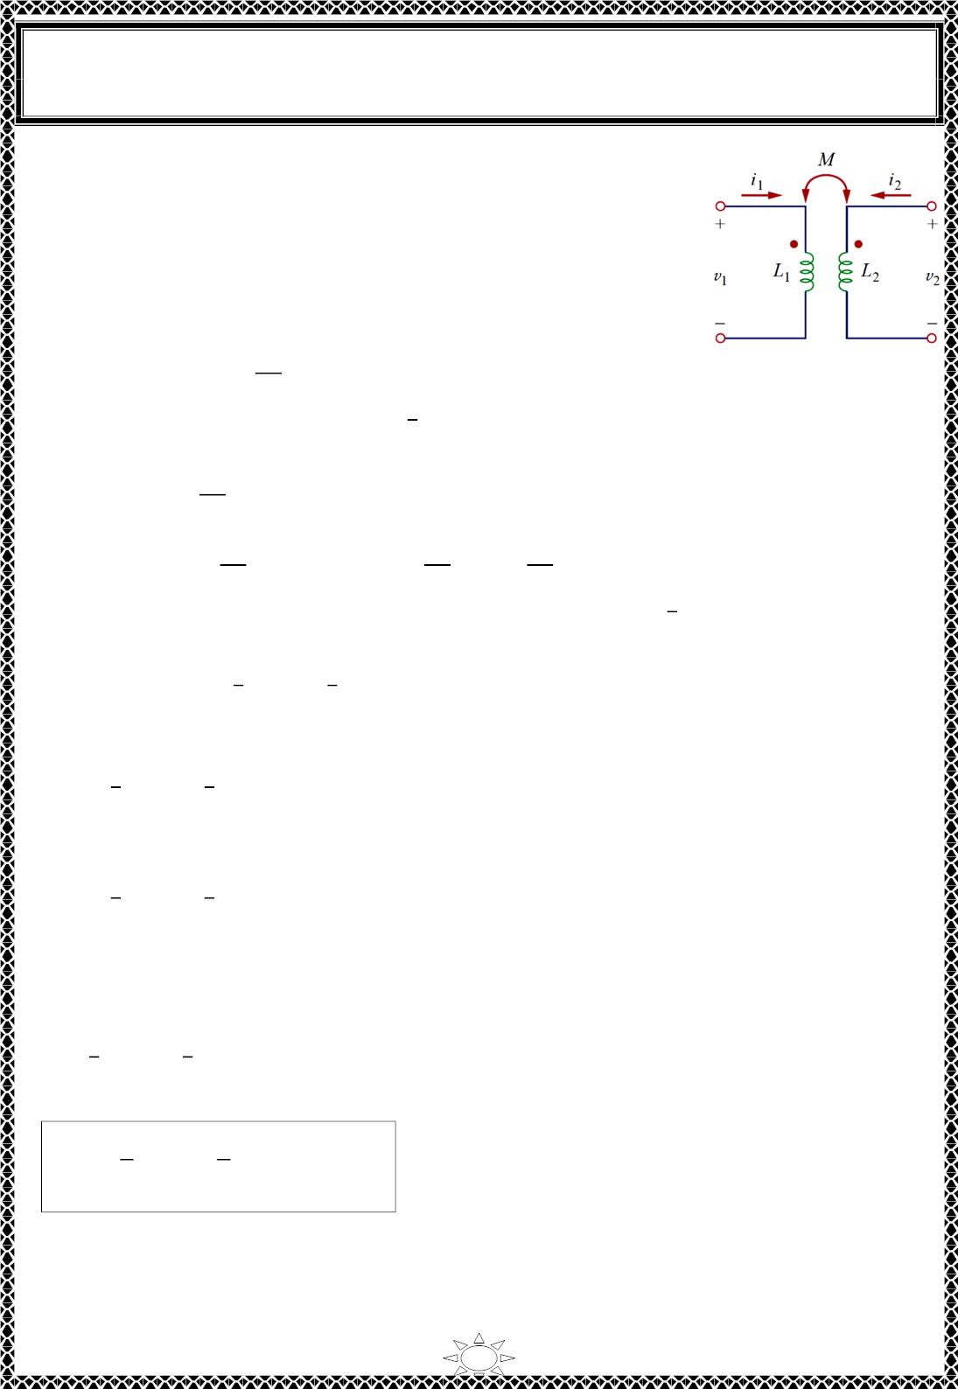
University of Diyala
Engineering College
Electronic Department
Electrical Circuits
2nd Class
Lecturer : Wisam N. AL-Obaidi
Year (2015-2016)
6) Energy in a Coupled Circuit
Consider circuit shown in Fig.6.1 ,
❖ If i and i are zero initially, the power and energy stored in
1
2
the coils is zero.
푝 (푡) = 푝 (푡) = 0 & 푤 = 푤 = 0
1
2
1
2
❖ If we let i increase from zero to I while maintaining
1
1
i₂ = 0, so
푝 (푡) = 푣 푖 = 푖 퐿
1 1
1
1 1
^{푑ꢀ}ꢁ
푑ꢂ
…(6.1)
…(6.2)
Fig.6.1
^{퐼}ꢁ
ꢃ
1
푤 = ∫ 푝 . dt = 퐿 ∫ 푖 . ꢄ푖 = 퐿 ꢅ²
1
1
1
1
1
2
1 1
❖ If we now maintain i = I and increase i from zero to I , the mutual voltage induced in
^{푑ꢀ}ꢆ
푑ꢂ
1
1
2
2
coil 1 is 푀₁₂
change. So
while the mutual voltage induced in coil 2 is zero, since i₁ does not
푝 (푡) = 푖 푀
^{푑ꢀ}ꢆ
푑ꢂ
^{푑ꢀ}ꢆ
푑ꢂ
^{푑ꢀ}ꢆ
푑ꢂ
2
1
12
+ 푖 푣 = ꢅ 푀
12
+ 푖₂퐿₂
…(6.3)
…(6.4)
2
2
1
^{퐼}ꢁ
ꢃ
^{퐼}ꢆ
ꢃ
1
푤 = ∫ 푝 ꢄ푡 = 푀 ꢅ ∫ ꢄ푖 + 퐿 ∫ 푖 ꢄ푖 = 푀 ꢅ ꢅ + 퐿 ꢅ²
2
2
12 1
2
2
2
2
12 1 2
2
2 2
Trail Version
Trail Version
Trail Version
Trail Version
Trail Version
Trail Version
Trail Version
Trail Version
Trail Version
Trail Version
Trail Version
Trail Version
Trail Version
❖ The total energy stored in the coils when both i and i have reached constant values is,
1
1
1
2
푤 = 푤 + 푤 = 퐿 ꢅ² + 퐿 ꢅ² + 푀 ꢅ ꢅ
12 1 2
…(6.5)
1
2
2
1 1
2
2 2
❖ If we first increase i from zero to I and later increase i from zero to I the total energy
2
2
1
1,
stored in the coils is
1
1
푤 = 퐿 ꢅ² + 퐿 ꢅ² + 푀 ꢅ ꢅ
…(6.6)
2
1 1
2
2 2
21 1 2
Compare Eq.s (6.5) with (6.6) we get,
푀₁₂ = 푀₂₁ = 푀
…(6.7)
…(6.8)
1
1
푤 = 퐿 ꢅ² + 퐿 ꢅ² + 푀ꢅ ꢅ
1 2
2
1 1
2
2 2
This equation was derived based on the assumption that the coil currents both entered the dotted
terminals. If one current enters one dotted terminal while the other current leaves the other dotted
terminal, the mutual voltage is negative, so that the mutual energy 푴푰 푰
is also negative. In that
case,
ퟏ ퟐ
1
1
푤 = 퐿 ꢅ² + 퐿 ꢅ² − 푀ꢅ ꢅ
…(6.9)
2
1 1
2
2 2
1 2
The instantaneous energy stored in the circuit the general expression
ꢇ
ꢇ
푤 = 퐿 ꢅ² + 퐿₂ꢅ₂² ∓ 푀ꢅ ꢅ
…(6.10)
ꢈ
1 1
ꢈ
1 2
8

Slide 4

University of Diyala
Engineering College
Electronic Department
Electrical Circuits
2nd Class
Lecturer : Wisam N. AL-Obaidi
Year (2015-2016)
7) Coupling coefficient (k)
We will now establish an upper limit for the inductance M. mutual The energy stored in
the circuit cannot be negative because the circuit is passive. This means that the quantity
1
1
( 퐿 푖
² + 퐿 푖² − 푀푖 푖
₁ ₂) must be greater than or equal to zero:
2
1 1
2
2 2
1
1
퐿 푖² + 퐿 푖² − 푀푖 푖 ≥ 0
…(7.1)
2
1 1
2
2 2
1 2
To complete the square, we both add and subtract the term 푖 푖 √퐿 퐿 on the right-hand
side of Eq. (6.11) and obtain
1 2
1 2
1
2
(푖 √퐿 − 푖 √퐿 ) + 푖 푖 (√퐿 퐿 − 푀) ≥ 0
…(7.2)
2
1
1
2
2
1 2
1 2
The squared term is never negative; at its least it is zero. Therefore, the second term on the
right-hand side of Eq. (6.12) must be greater than zero; that is,
√퐿 퐿 − 푀 ≥ 0
1
2
or
푀 ≤ √퐿₁퐿₂
…(7.3)
Thus, the mutual inductance cannot be greater than the geometric mean of the self-
inductances of the coils. The extent to which the mutual inductance M approaches the
upper limit is specified by the coefficient of coupling k, given by
Trail Version
Trail Version
Trail Version
Trail Version
Trail Version
Trail Version
Trail Version
Trail Version
Trail Version
Trail Version
Trail Version
Trail Version
Trail Version
푘 =
ꢀ
…(7.4)
…(7.5)
√ꢁ_{ꢂ}ꢁ_{ꢃ}
푀 = 푘√퐿₁퐿₂
Where 0 ≤ 푘 ≤ ꢄ or equivalently 0 ≤ 푀 ≤ √퐿 퐿 .
1
2
The coupling coefficient is the fraction of the total flux emanating from one coil that links the other
coil. For example, in Fig.6.2(a),
∅
∅ꢂꢃ
ꢂꢂ^{ꢅ∅}
푘 = ^{ꢂꢃ} =
…(6.6)
∅
∅
ꢂ
ꢂꢃ
and in Fig.6.2(b),
∅
∅ꢃꢂ
푘 = ^{ꢃꢂ} =
…(6.7)
∅
∅
ꢅ∅
ꢃ
ꢃꢂ
ꢃꢃ
1) For k = 1 (the entire flux produced by one coil links another coil, 100% coupling )
the coils are said to be perfectly coupled.
2) For k < 0.5 coils are said to be loosely coupled;
3) For k > 0.5, coils are said to be tightly coupled.
The coupling coefficient k is a measure of the magnetic coupling between two
coils; 0 ≤ k ≤ 1
coupling coefficient k depend on the closeness of the two coils, their core, their orientation, and their
windings.
9

Slide 5
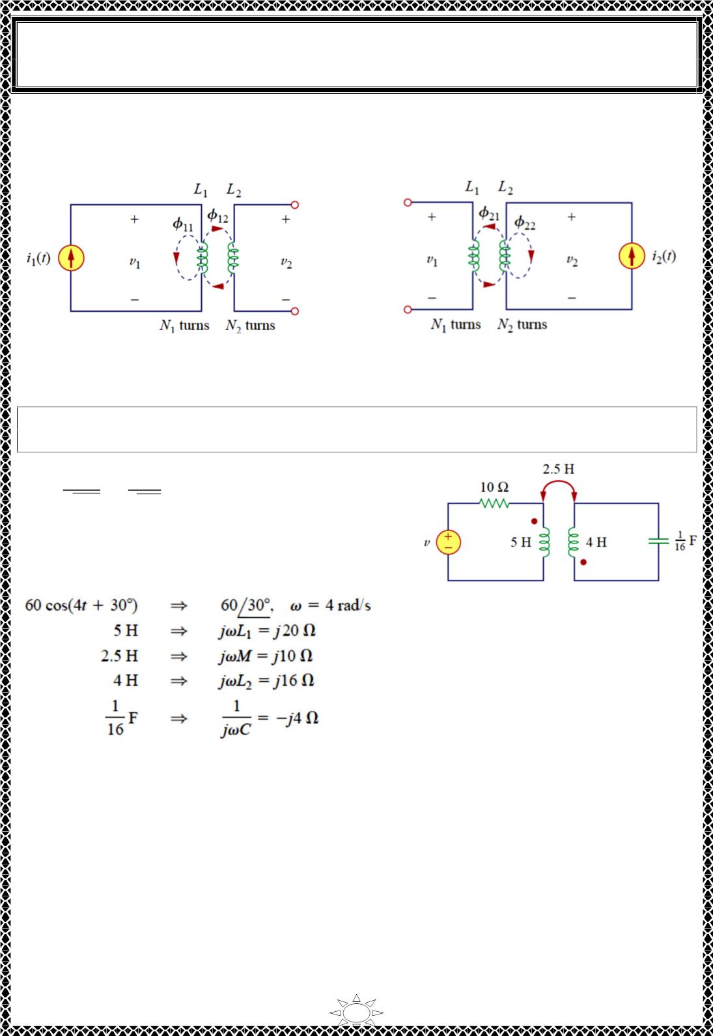
University of Diyala
Engineering College
Electronic Department
Electrical Circuits
2nd Class
Lecturer : Wisam N. AL-Obaidi
Year (2015-2016)
The air-core transformers used in radio frequency circuits are loosely coupled, whereas
iron-core transformers used in power systems are tightly coupled. The linear transformers
are mostly air-core; the ideal transformers are principally iron-core.
(a)
(b)
Fig.6.2
Example 5: Determine the coupling coefficient and calculate the energy stored in the
coupled inductors at time t=1 s if v = 60cos(4t +30º) V.
Solution:
Trail Version
Trail Version
Trail Version
Trail Version
Trail Version
Trail Version
Trail Version
Trail Version
Trail Version
Trail Version
Trail Version
Trail Version
푀
Trail Version
푘 =
=
ꢀ.5
= 0.ꢂ6 (tightly coupled)
√퐿₁퐿₂
ꢁ5×4
To find the energy stored, we need to calculate the
current. To find the current, we need to obtain the
frequency-domain equivalent of the circuit.
The frequency-domain equivalent is shown in Fig.. Now apply mesh analysis.
For mesh 1,
(ꢃ0 + 푗ꢄ0)퐼 + 푗ꢃ0퐼 = 60∠30^{ꢆ}
…(1)
…(2)
ꢅ
ꢀ
For mesh 1,
푗ꢃ0퐼 + (푗ꢃ6 − 푗ꢇ)퐼 = 0
ꢅ
ꢀ
Solve Eq.s (1) and (2) we get,
퐼 = 3.90ꢂ∠−ꢃ9.ꢇ^{표} A
In time domain.
푖 = 3.90ꢂ cos(ꢇ푡 − ꢃ9.ꢇ^{표}) &
At t=1s, 4t = 4 rad = 229.2º
퐼ꢀ = 3.ꢄꢂꢇ∠ꢃ60.6^{표} A
ꢅ
&
ꢅ
푖ꢀ = 3.ꢄꢂꢇ cos(ꢇ푡 + ꢃ60.6^{표})
푖_{ꢅ} = 3.90ꢂ cos(ꢄꢄ9.ꢄ^{표} − ꢃ9.ꢇ^{표}) = −3.389 A
10

Slide 6
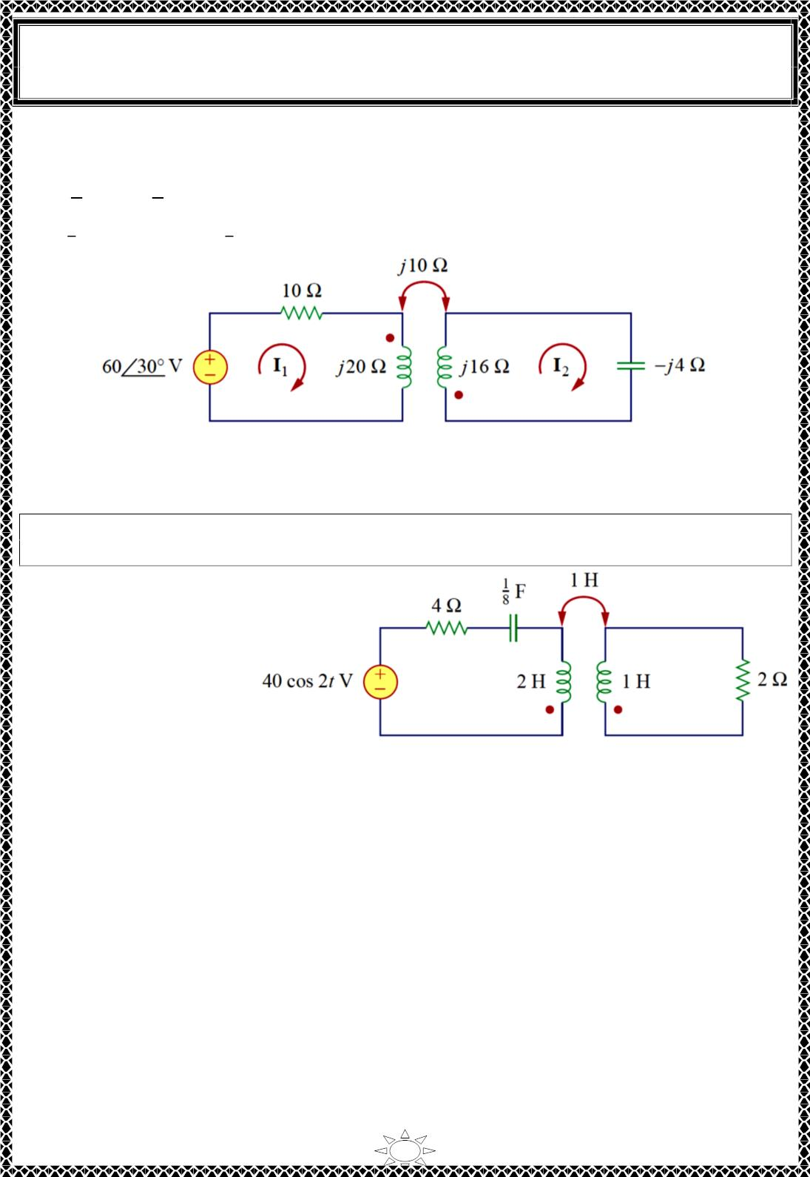
University of Diyala
Engineering College
Electronic Department
Electrical Circuits
2nd Class
Lecturer : Wisam N. AL-Obaidi
Year (2015-2016)
푖₂ = 3.ꢀ54 cos(ꢀꢀ9.ꢀ^{표} + 160.6^{표}) = ꢀ.8ꢀ4 A
The total energy stored in the coupled inductors is,
1
1
푤 = 퐿 푖² + 퐿₂푖₂² + 푀푖 푖
ꢀ
ꢁ ꢁ
ꢀ
ꢁ 2
ꢁ
ꢁ
= (5)(−3.389)² + (4)(ꢀ.8ꢀ4)² + ꢀ.5(−3.389)(ꢀ.8ꢀ4) = ꢀ0.73 퐽
2
2
Frequency-domain equivalent circuit
H.W.3: Determine the coupling coefficient and calculate the energy stored in the coupled
inductors at time t=1.5 .
Answer:
0.7071, 39.4 J.
Trail Version
Trail Version
Trail Version
Trail Version
Trail Version
Trail Version
Trail Version
Trail Version
Trail Version
Trail Version
Trail Version
Trail Version
Trail Version
11

Slide 7
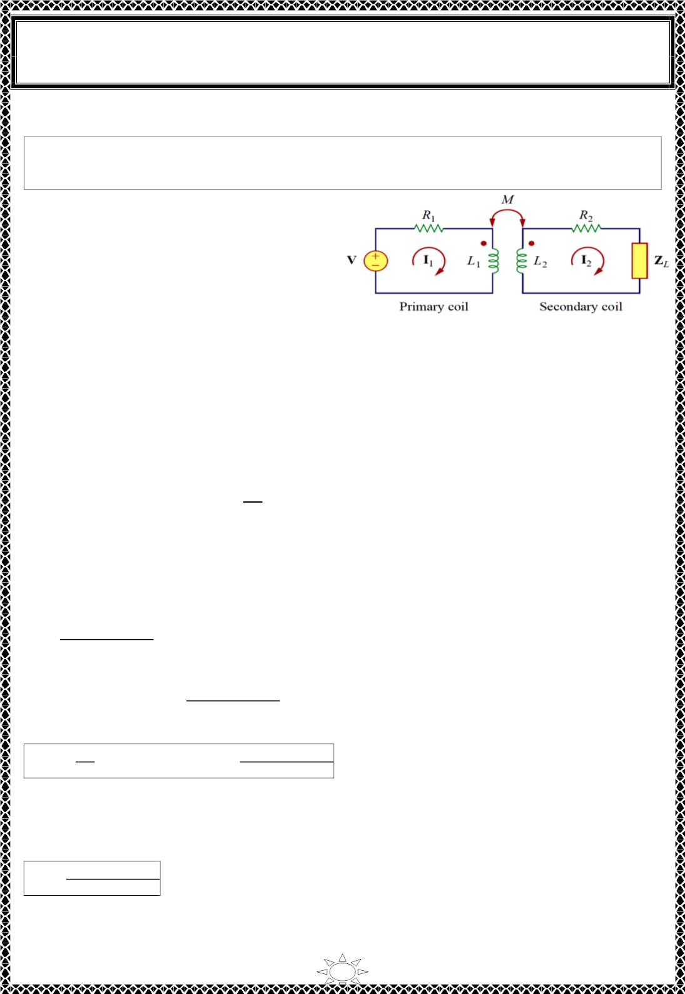
University of Diyala
Engineering College
Electronic Department
Electrical Circuits
2nd Class
Lecturer : Wisam N. AL-Obaidi
Year (2015-2016)
8) Linear Transformers
A transformer is generally a four-terminal device comprising two (or more)
magnetically coupled coils.
As shown in Fig.8.1, the coil that is directly
connected to the voltage source is called the
primary winding. The coil connected to the
load is called the secondary winding. The
resistances R and R are included to
1
2
account for the losses (power dissipation)
in the coils.
Fig.8.1 A linear transformer
The transformer is said to be linear if the coils are wound on a magnetically linear material(a
material for which the magnetic permeability is constant). Such materials include air, plastic,
Bakelite, and wood. In fact, most materials are magnetically linear. Linear transformers
are sometimes called air-core transformers, although not all of them are necessarily air-core.
They are used in radio and TV sets.
Trail Version
Trail Version
Trail Version
Trail Version
Trail Version
Trail Version
Trail Version
Trail Version
Trail Version
Trail Version
Trail Version
Trail Version
Trail Version
푽
The input impedance (풁_{풊풏} =
^{퐈}_{ퟏ}) as seen from the source governs the behavior of the
primary circuit.
Applying KVL to the two meshes in Fig.8.1 gives
푉 = ( 푅 + 푗휔퐿 )퐼 − 푗휔푀퐼
…(8.1)
…(8.2)
1
1
1
2
0 = −푗휔푀퐼 + ( 푅 + 푗휔퐿 + 푍 )퐼
1
2
2
ꢀ
2
From Eq.(8.2)
퐼₂ =
ꢁꢂꢃ
퐼₁
…(8.3)
…(8.4)
…(8.5)
( ꢄ ꢆ ꢁꢂꢀ ꢆꢇ )
ꢅ
ꢅ
ꢈ
Substitute Eq. (8.3) in (8.1) we get,
푉 = ꢉ( 푅 + 푗휔퐿 ) +
ꢂ^{ꢅ}ꢃ^{ꢅ}
ꢊ 퐼₁
1
1
( ꢄ ꢆ ꢁꢂꢀ ꢆꢇ )
From Eq. (8.4) we get,
ꢅ
ꢅ
ꢈ
풁 =
풊풏
푽
= ( 푅 + 푗휔퐿 ) +
1 1
ꢂ^{ꢅ}ꢃ^{ꢅ}
( ꢄ ꢆ ꢁꢂꢀ ꢆꢇ )
퐈
ퟏ
ꢅ
ꢅ
ꢈ
Notice that the input impedance comprises two terms. The first term, ( 푅 + 푗휔퐿 ), is the
1
1
primary impedance. The second term is due to the coupling between the primary and
secondary windings. It is as though this impedance is reflected to the primary. Thus, it is
known as the reflected impedance ZR and
푍_{ꢄ} =
ꢂ^{ꢅ}ꢃ^{ꢅ}
…(8.6)
( ꢄ ꢆ ꢁꢂꢀ ꢆꢇ )
ꢅ
ꢅ
ꢈ
It should be noted that the Eq. (8.5) or (8.6) is not affected by the location of the dots on
the transformer, because the same result is produced when M is replaced by -M.
12

Slide 8
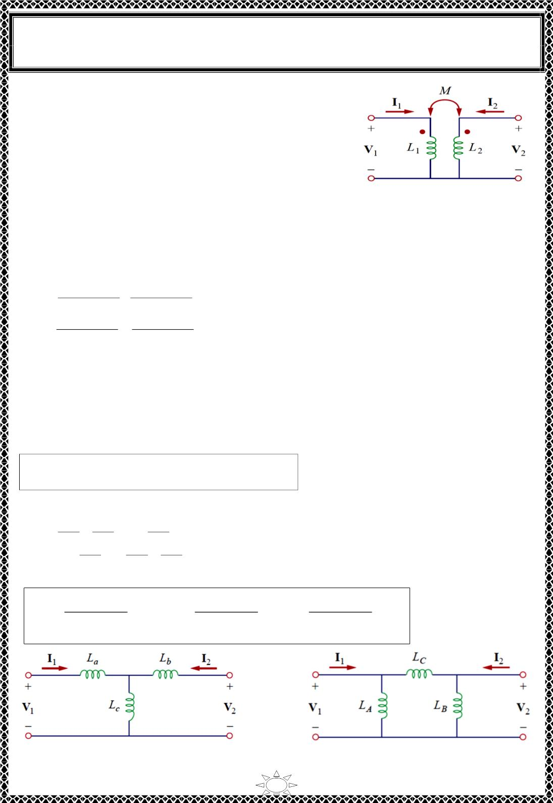
University of Diyala
Engineering College
Electronic Department
Electrical Circuits
2nd Class
Lecturer : Wisam N. AL-Obaidi
Year (2015-2016)
9) Conductively Coupled Equivalent Circuits
It is convenient to replace a magnetically coupled circuit
by an equivalent circuit with no magnetic coupling. Now
to replace the linear transformer in Fig.8.2 by an
equivalent T or Π circuit, a circuit that would have no
mutual inductance.
Fig.8.2
The voltage-current relationships for the primary and secondary coils give the matrix
equation
V
푗휔퐿 푗휔푀 퐼
[
1_{] = ꢀ}
2
1
ꢁ [
1]
2
…(9.1)
…(9.2)
V
푗휔푀 푗휔퐿 퐼
2
By matrix inversion, this can be written as
ꢄ
퐿₂
2
−푀
ꢇ
퐼
1_{] =}
퐼
2
푗휔(퐿₁퐿₂− 푀
푗휔(퐿₁퐿₂− 푀²
V
V
[
−푀
)
^{퐿}1
)
[
1]
2
ꢃ
ꢂ
2
2 ꢆ
)
푗휔(퐿 퐿 − 푀
푗휔(퐿 퐿 − 푀
1
2
)
1 2
ꢅ
Trail Version
Trail Version
Trail Version
Trail Version
Trail Version
Trail Version
Trail Version
Trail Version
Trail Version
Trail Version
Trail Version
Trail Version
Trail Version
1) For the T (or Y) network of Fig.8.3, mesh analysis provides the terminal equations as
V
V
푗휔ꢈ퐿 + 퐿 ꢉ
푗휔퐿_{푐}
푗휔ꢈ퐿 + 퐿 ꢉ 퐼
1_{] = ꢀ}
2
푐
퐼
[
푎
ꢁ [
1]
2
…(9.3)
푗휔퐿
푐
푏
푐
If the circuits in Fig.8.2 and Fig.8.3 are equivalents, Eqs. (9.1) and (9.3) must be identical.
Equating terms in the impedance matrices of Eqs. (9.1) and (9.3) leads to
퐿 = 퐿 − 푀,
퐿 = 퐿 − 푀, 퐿 = 푀
ꢌ ꢍ ꢎ
ꢊ
ꢋ
…(9.4)
2) For the Π (or ∆) network in Fig.8.4, nodal analysis gives the terminal equations as
퐼
1_{] =}
퐼
2
1
+
1
− ¹
^{ꢇ} V
ꢄ
푗휔퐿
푗휔퐿
푗휔퐿
퐶
1]
2
…(9.5)
[
퐴
퐶
[
1
푗휔퐿
1
1
V
ꢃ
ꢂ
−
푗휔퐿
+
ꢆ
ꢅ
퐶
퐵
푗휔퐿
퐶
Equating terms in admittance matrices of Eqs. (9.2) and (9.5), we obtain
퐿 퐿 − 푀^{ꢍ}
퐿 퐿 − 푀^{ꢍ}
퐿 퐿 − 푀^{ꢍ}
ꢋ ꢍ
퐿_{ꢏ} =
ꢋ
ꢍ
,
퐿_{ꢐ} =
ꢋ
ꢍ
, 퐿_{ꢑ} =
…(9.6)
퐿_{ꢍ} − 푀
퐿_{ꢋ} − 푀
푀
Fig.8.3 An equvalient T circuit
Fig.8.4 An equvalient Π circuit
13

Slide 9
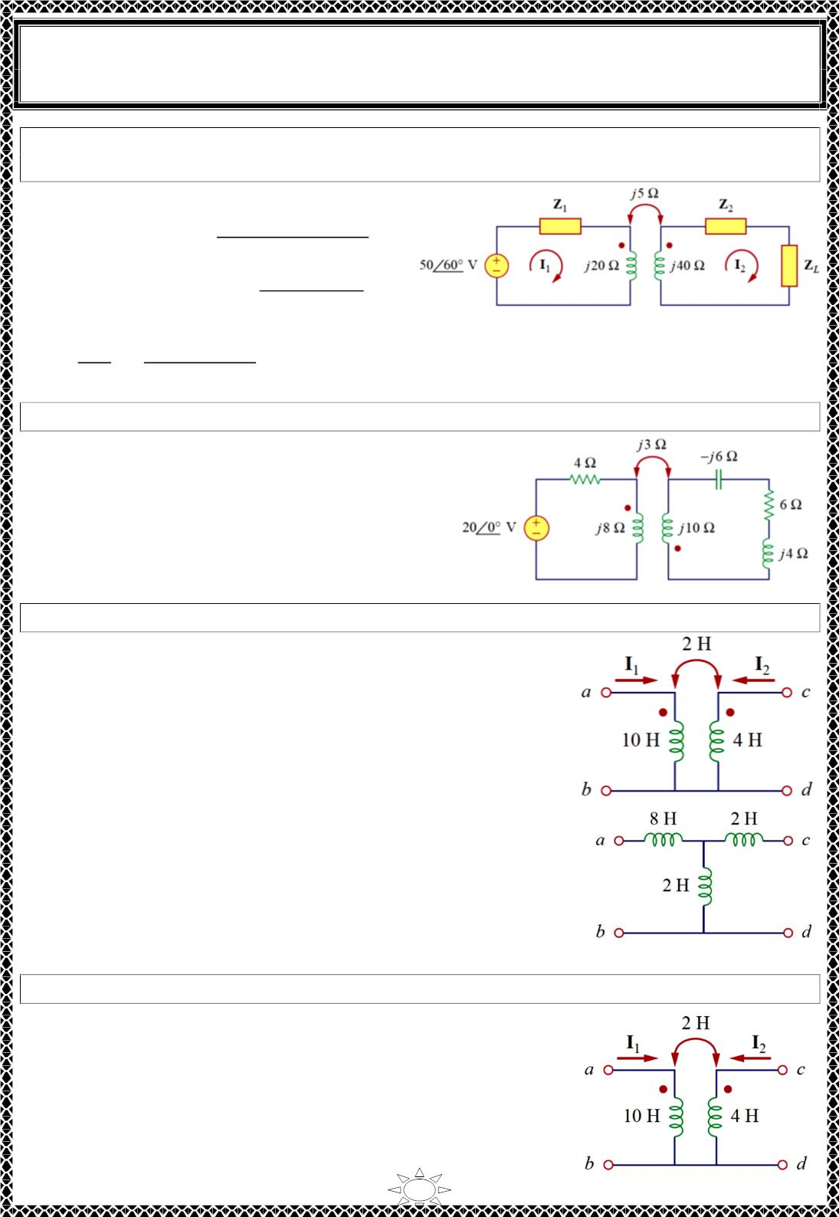
University of Diyala
Engineering College
Electronic Department
Electrical Circuits
2nd Class
Lecturer : Wisam N. AL-Obaidi
Year (2015-2016)
Example 6: In the circuit shown, calculate the input impedance and current I . Take 푍 =
60 − 푗ꢀ00 Ω, 푍 = 30 + 푗40Ω and 푍 = 80 + 푗60Ω
1
1
2
퐿
Solution: From Eq.(8.22)
5²
푍 = ( 푍 + 푗ꢁ0) +
푖푛
1
(푗40 + 푍 + 푍 )
2
퐿
= 60 − 푗ꢀ00 + 푗ꢁ0 +
ꢁ5
ꢀꢀ0 + 푗ꢀ40
= 60.09 − 푗80.ꢀꢀ = ꢀ00.ꢀ4∠ − 53.ꢀ^{표}Ω
푉
ꢈ
퐼₁ =
=
ꢅꢆ∠ꢇꢆ
= 0.5∠ꢀꢀ3.ꢀ^{표} A
ꢂ_{ꢃꢄ}
1ꢆꢆ.1ꢉ∠ꢊꢅꢋ.1^{ꢈ}
H.W.4: Find the input impedance of the circuit and the current from the voltage source.
Answer:
8.58∠58.05^{표}Ω, ꢁ.33ꢀ∠−58.05^{표} A
Trail Version
Trail Version
Trail Version
Trail Version
Trail Version
Trail Version
Trail Version
Trail Version
Trail Version
Trail Version
Trail Version
Trail Version
Trail Version
Example 7: Determine the T-equivalent circuit of the linear transformer shown.
Solution:
ꢌ = ꢀ0, ꢌ = 4, and 푀 = ꢁ
1
2
ꢌ = ꢌ − 푀 = ꢀ0 − ꢁ = 8 H,
푎
1
ꢌ = ꢌ − 푀 = 4 − ꢁ = ꢁ H,
푏
2
ꢌ_{푐} = 푀 = ꢁ H
We have assumed that reference directions for currents and
voltage polarities in the primary and secondary windings
conform to those in Fig.15 . Otherwise, we may need to
replace 푀 with −푀, as Example 8 illustrates. The T-equivalent
circuit is shown in Fig.
H.W.5: For the linear transformer , find the equivalent network.
Answer:
ꢌ_{퐴} = ꢀ8 H,
ꢌ = 4.5 H, ꢌ = ꢀ8 H
퐵 퐶
14

Slide 10
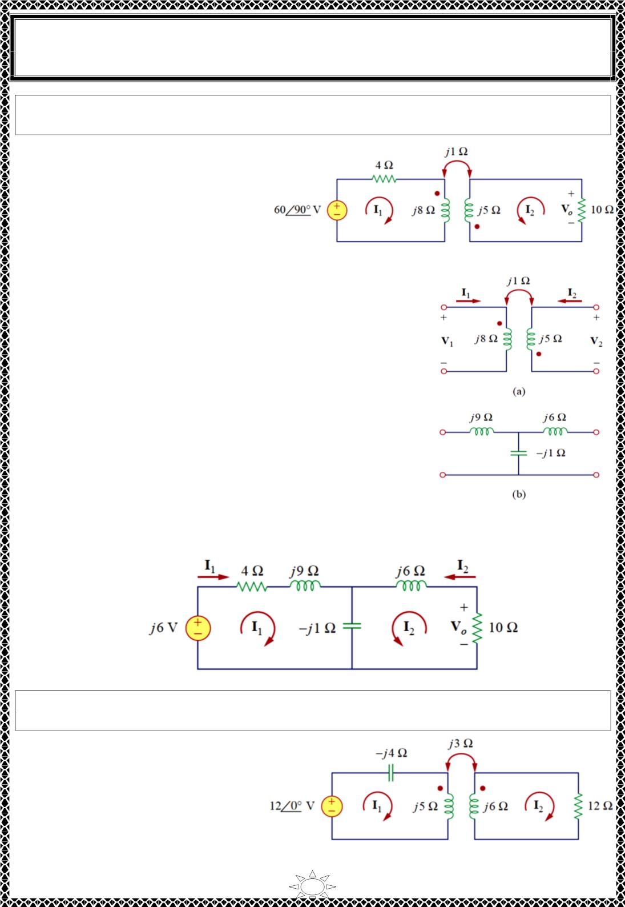
University of Diyala
Engineering College
Electronic Department
Electrical Circuits
2nd Class
Lecturer : Wisam N. AL-Obaidi
Year (2015-2016)
Example 8: Solve for I , I and V using the T-equivalent circuit for the linear
transformer.
Solution:
1
2
O
퐿 = 8, 퐿 = 5, and 푀 = −ꢀ
1
2
퐿 = 퐿 − 푀 = 8 − (−ꢀ) = 9 H,
푎
1
퐿 = 퐿 − 푀 = 5 − (−ꢀ) = 6 H,
푏
2
퐿_{푐} = 푀 = −ꢀ H
To represent the circuit in frequency domain as ω is not
specified , we assume ω =1 rad, and the equavalent T circuit in
frequency domain is shown in Fig.
Apply mesh analysis,
For mesh 1,
푗6 = (4 + 푗9 − 푗ꢀ)퐼₁ + (−푗ꢀ)퐼₂
For mesh 2,
0 = (−푗ꢀ)퐼₁ + (ꢀ0 + 푗6 − 푗ꢀ)퐼₂
…(1)
…(2)
Trail Version
Trail Version
Trail Version
Trail Version
Trail Version
Trail Version
Trail Version
Trail Version
Trail Version
Trail Version
Trail Version
Trail Version
Trail Version
Solve Eq.s (1) & (2) we get,
퐼₁ = 0.6 + 푗0.3 A,
퐼 = 푗0.06 A & 푉 = −ꢀ0퐼 = 푗0.6 V
2 푂 2
The complete equavalent T circuit in frequency domain is
shown in Fig below.
H.W.6: Calculate the phasor currents I and I in the circuit shown (in example3) using
1
2
the T-equivalent model for the magnetically coupled coils.
Answer:
ꢀ3∠−49.4^{표}A,
ꢁ.9ꢀ∠ꢀ4.04^{표} A
15

